Slide 1
“Understanding Sexual Development In
Individuals With Autism”
Dr. Ruwinah Abdul Karim
Clinical Director
Penawar Special Learning Centre

Slide 2

DR. RUWINAH ABDUL KARIM
CLINICAL DIRECTOR
PENAWAR SPECIAL LEARNING CENTRE (PSLC)
UNDERSTANDING SEXUAL DEVELOPMENT IN
INDIVIDUALS WITH AUTISM

Slide 3
MYTHS ON SEXUALITY among INDIVIDUALS WITH AUTISM
Consistently perceived as a young child and in need of protection.
Possesses heightened desires compared to typical individuals.
Lacks sexual urges or drives and does not necessitate sexual education.
Unlikely to engage in sexual offenses.

Slide 4
COMMON ISSUES…
Touching others inappropriately.
Being nude in public.
Talking about inappropriate subjects at inappropriate moments.
Lack of understanding on managing sexual emotions and urges.
Masturbation.

Slide 5
COMMON ISSUES…
Quick to trust others.
Difficulty distinguishing between appropriate and inappropriate behaviors.
Sexual arousal triggered by specific objects or characters.

Slide 6

ON THE WAY TO PUBERTY
Changes in emotions.
Fluctuations in mood.
Feelings of anxiety.
Episodes of anger.
Displays of aggression.
Decreased motivation.

Slide 7
OTW TO PUBERTY - MASTURBATION
Experiencing infections.
Importance of maintaining cleanliness in private areas.
Wearing inappropriate or excessively tight underwear.
Exposure to others engaging in sexual activities through observation or media.
Experiencing medication side effects that increase libido.

Slide 8
Essential Lessons: What to Cover
Educate socially appropriate behaviours
Educate child in saying “NO”
Prevent unwanted behaviour
Personal care and hygiene
Human body parts

Slide 9
Essential Lessons: TECHNIQUES
Start as early as possible.
Lay the groundwork - understanding boundaries, consent and body awareness.
Utilise a multi-sensory approach incorporating visual aids, social stories, and simplified language to effectively convey concepts.
Enhance retention through repetitive learning techniques and real-life scenarios.
Focus on fundamental aspects of body anatomy, personal space and appropriate touch to foster understanding and safety.

Slide 10
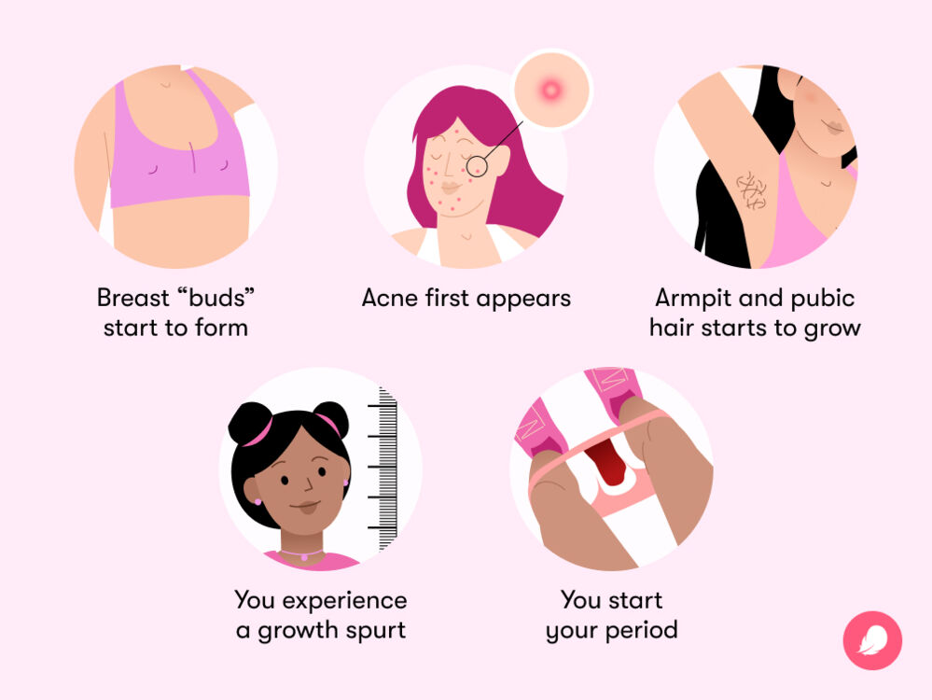
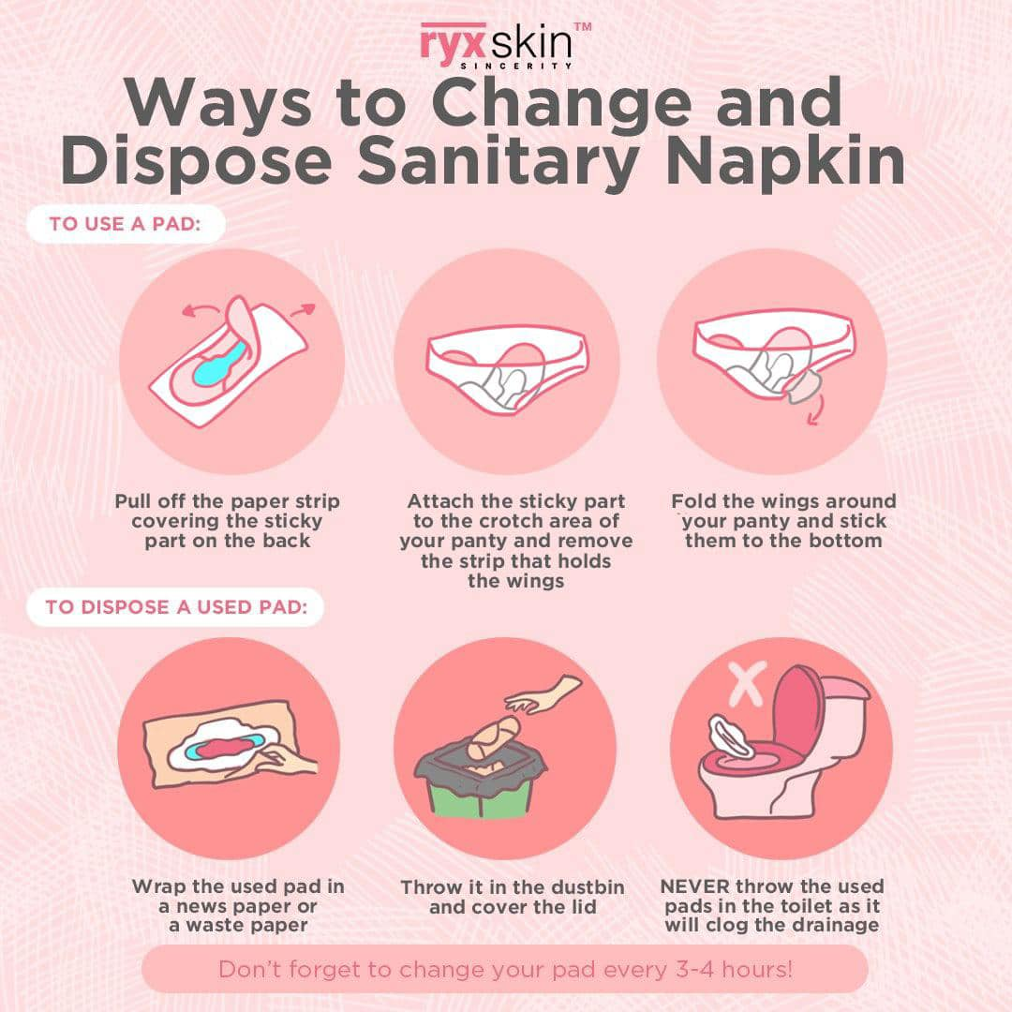
MENSTRUATION

Slide 11
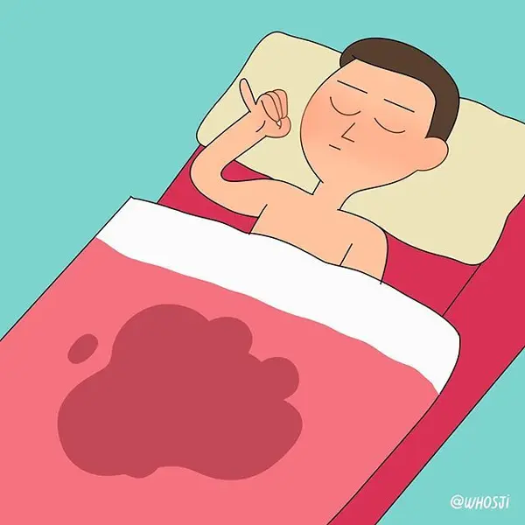
WET DREAMS
Describe the process of semen release from the penis.
Explain the possibility of waking up with a wet spot.
Provide guidance on what to do after experiencing these events.

Slide 12
THANK YOU ruwinah@hospitalpenawar.com

